Slide 1
GENARAL INSURANCE
Let’s ensure to make an insurance ……..

Slide 2
Welcome!
YOUR LOGO
TEAM DETAILS
Aakash Sunilbhai Patel
Mangala Vamsi Krishna
Sharanbasappa
SaiSindhu Nomula
Thanks for joining us
Notes:
© Copyright Showeet.com – Free PowerPoint Templates

Slide 3
Agenda
YOUR LOGO
01
Problem Statement
04
FLOWCHART
02
05
Technologies
Database diagram
03
06
ScrumBoard
The site
Notes:
© Copyright Showeet.com – Free PowerPoint Templates

Slide 4
PROBLEM STATEMENT
The existing insurance systems require an agent to act as a mediator between the insurance company and the customer. This leads to extra charges of payments in terms of brokerage and token money to the customer. There is no existing provision for tracking the status of Insurance application of the customer. The customer document verification needs to be done by the agent by manually visiting the customer or by having the Customer visit the company center.

Slide 5
Technologies used for developing an effective application!
01
Front End
02
Back END
03
DATABASE
FrontEnd :
Angular
Node js
Bootstrap
Backend :
ASP.NET
Database:
SQL Management studio
Notes:
© Copyright Showeet.com – Creative & Free PowerPoint Templates

Slide 6
THE SITE: The website was built using Angular ,ASP.NET. and information of this application is stored using Sql server
Homepage
Buy Insurance
Renew Insurance
Here all the modules of general insurance are displayed and the user can login from here , can know about general insurance, can contact us .
The user can buy an insurance if he is an registered user , else he can register and login here.
The user can renew the insurance .
Calculate Premium
Claim Insurance
User can find the estimate of the insurance
The user can claim his insurance
Notes:
© Copyright Showeet.com – Free PowerPoint Templates

Slide 7
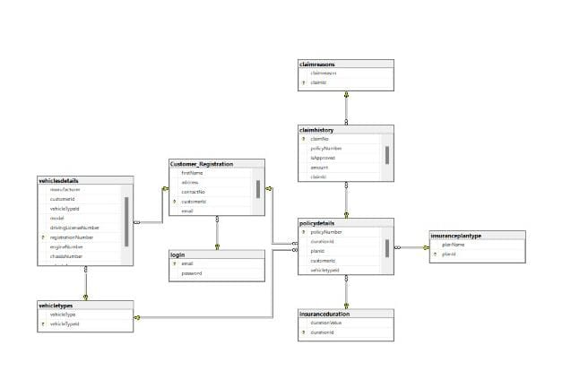
Database Diagram

Slide 8
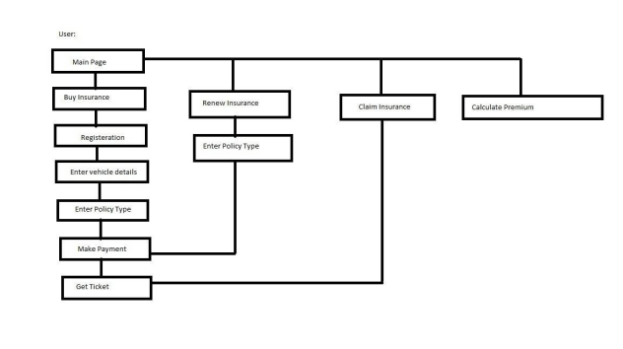
FlowChart

Slide 9
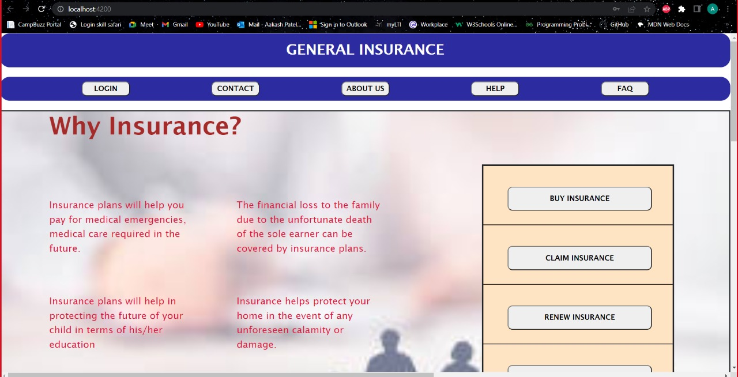
HOMEPAGE

Slide 10
BUYINSURANCE
Here in Buyinsurance the user can purchase an insurance policy for his vehicle.
To get a policy a customer need to register and provide his vehicle details and then he need to select the plan type according to his convience and select the duration of the plan and make payment .
If the user want to buy a insurance then he should select on buy insurance and then he should be navigated to the page where he should register himself
Then he need to enter the vehicles details and what type of vehicle he is buying an insurance.
Then he will be navigated to a page where he will be asked select plan type and duration of the plan
Then he make payment
His policy will be registered

Slide 11
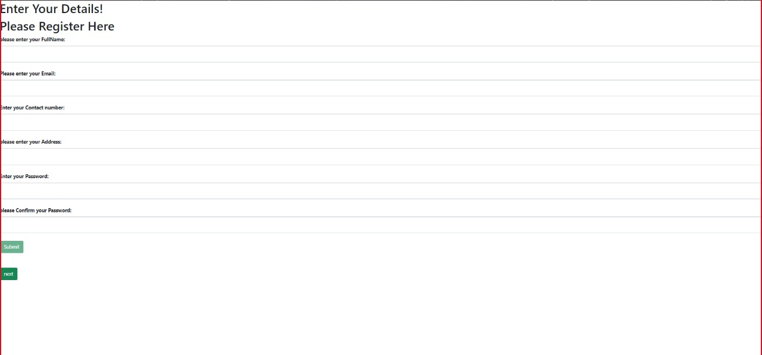

Slide 12
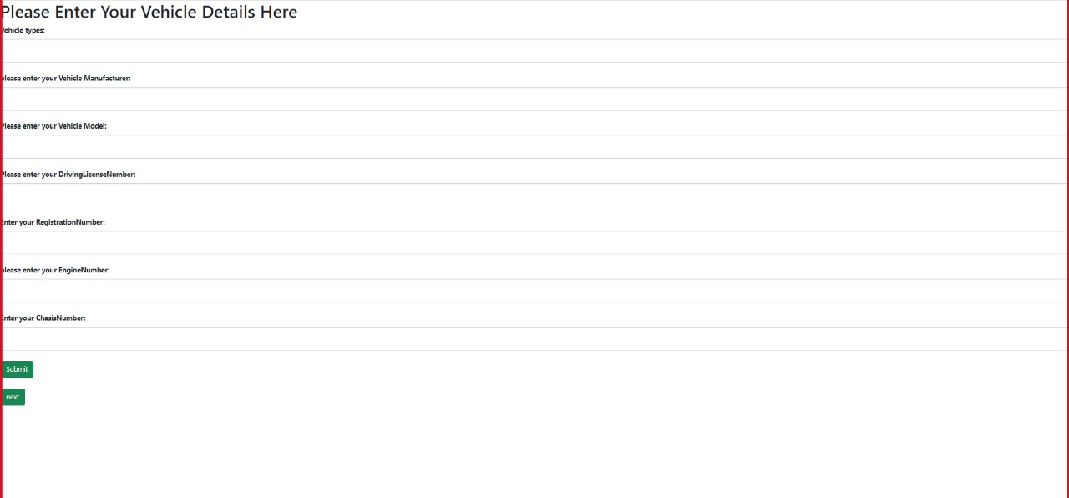

Slide 13
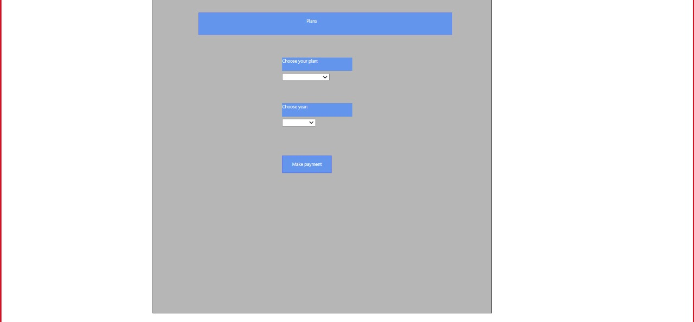

Slide 14
Claim Insurance
Here the user can claim his insurance if his vehicle was damaged due some conditions which are mentioned in the policy claim details
To claim the insurance the he should click on claim insurance and he should be navigated to a page he need to enter his policy details and select the reason for claim .
Then the details will be posted to admin .and if he approves the customer claim will be approved to the customer.

Slide 15
RENEW INSURANCE
If the user want to renew his existing policy .i.e, we he want to extend the existing policy or change the plan type , he can do that here .
Click on claim insurance he will be navigated to claim page where he need to enter the policy details and then he will be navigated to the next page where he will be able to select the tenure and plan type again as per his requirement.
And the existing policy will be updated .

Slide 16
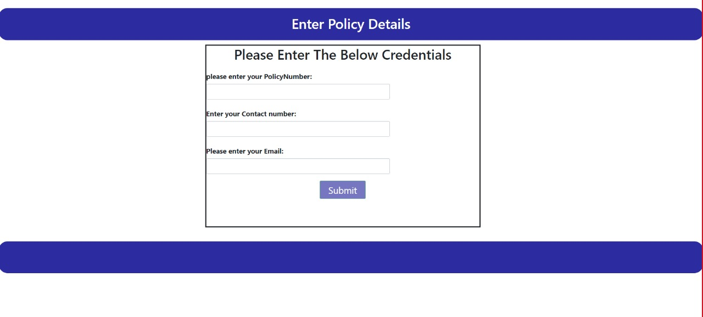

Slide 18
CALCULATE PREMIUM
Here in this module before the user buy his insurance he can calculate the premium amount ,
The user need to click on calculate premium and enter the vehicle type and then enter the age of the vehicle
He will be displayed with some certain amount how much he need to pay .

Slide 19
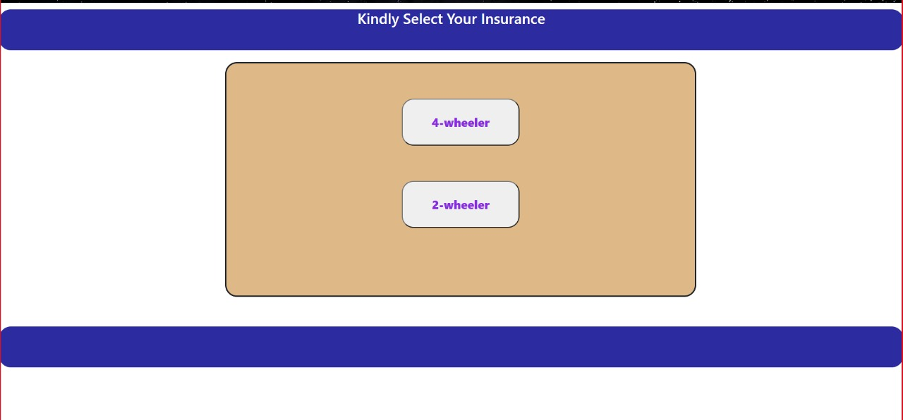

Slide 20
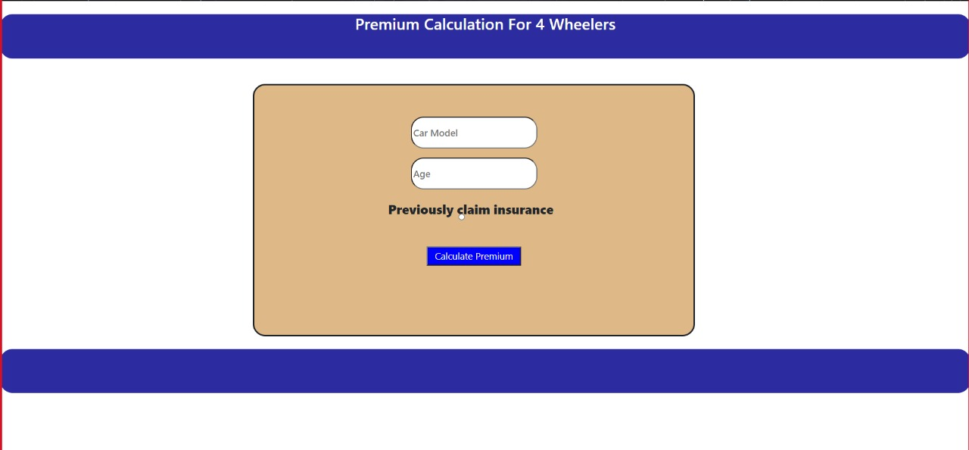

Slide 21
